Slide 1

Project Report
Employee Attrition
Summary
Intro
Correlation
EDA
DESIGNED BY:
Gursimar Singh Bedi
Code Snipped in Notes
Takenmind Internship Project Submission

Slide 2
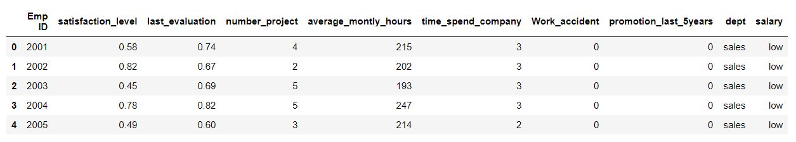
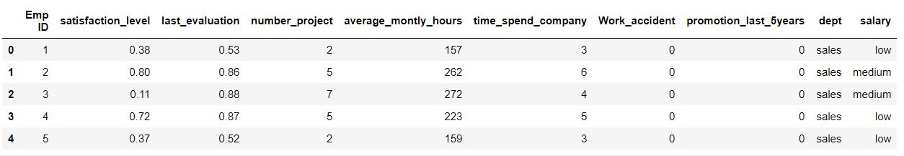
Current Employee Table – Head
Employee Who Left Table – Head()
Summary
Intro
Correlation
EDA

Slide 3
Columns
Employee Attrition Database
Employee ID: Uniquely Identifies each record in the table
Satisfaction Level: Value [0-1] to determine their levels of satisfaction
Last evaluation: Series Value [0-1]
Number of projects: Ordinal Data [2-6]
Average monthly hours: Series Value [96-287]
Time spent at the company: in years, value ranging from [2-10]
Whether they have had a work accident: Binary Value [0,1]
Whether they have had promotion in last 5 years: Binary Value [0-1]
Departments: Cardinal data representing different departments
Salary: Ordinal Data ( High , medium, low)
Summary
Intro
Correlation
EDA

Slide 4
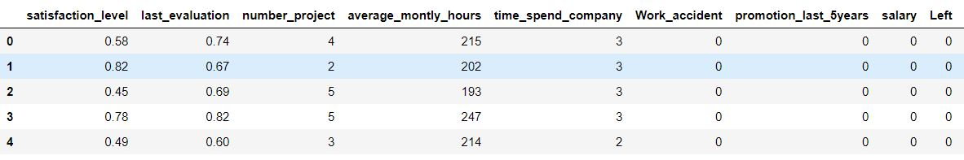
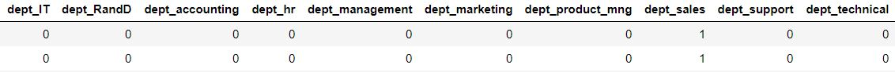
Data Cleaning and Pre-Processing
Employee Attrition Database
There were no null values in the dataset.
There were no outliers or absurd values in the dataset. (checked through describe.
Emp_ID column was dropped as it wasn’t of any significance
Both tables were combined and a new column Left (target Column) was introduced for predictions.
Summary
Correlation
Intro
EDA
Final Dataset – Head

Slide 5
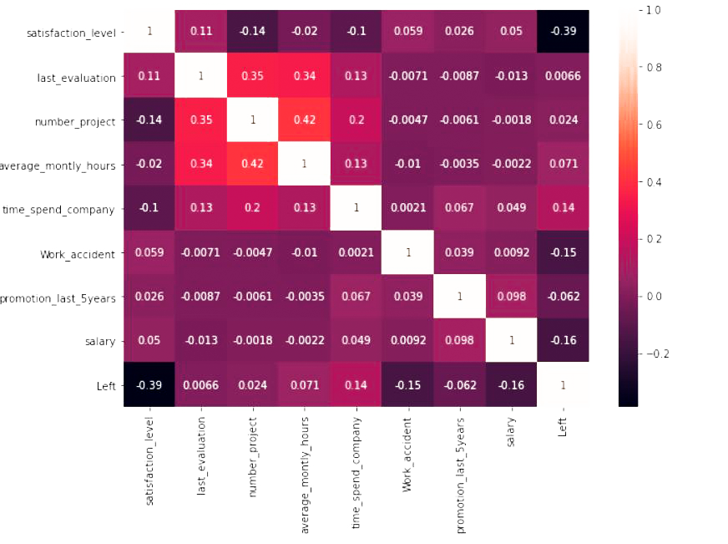
Correlation – a pivotal component
Correlation is defined as the process of establishing a relationship or connection between two or more measures.
Summary
Intro
Correlation
According to Correlation Satisfaction_Level is the most important to determining the attrition. Salary, Work_Accident, and time spend are the highly important as well.
As all features have low correlation, all of them are indispensable.
Notes:
plt.figure(figsize=(10,7))
sns.heatmap(df.corr(),annot=True)
plt.show()

Slide 6
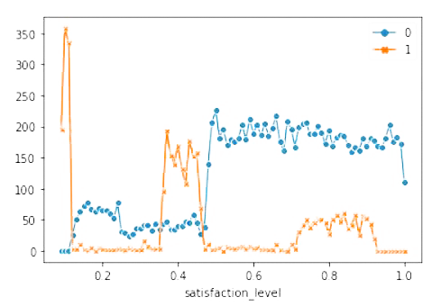
Satisfaction (0.39)
Key
Intro
Summary
Correlation
Significance
EDA
Satisfaction Level as a metric is pretty reliable in terms of determining the attrition rate. The probability of an employee leaving is significantly lower after his/her satisfaction level reaches 0.435.
The lowest attrition rate is below 0.1 satisfaction but these employees will be difficult to retain.
The company should focus on employees with satisfaction between 0.38 and 0.43 this is the range for the second spike
Notes:
sl=pd.crosstab(df["satisfaction_level"], df["Left"])
sns.lineplot(data=sl, markers=True, dashes=False)

Slide 7
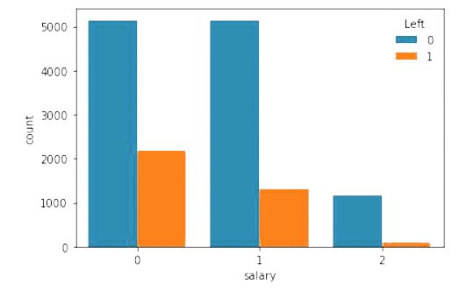
Salary (-0.16)
Key
Intro
Summary
Correlation
Significance
EDA
Attrition Rates based on salary
Low = 70.312%
Medium = 79.569%
High = 93.371%
While the sample size of low and medium salary is comparable, Employees with low salary have a greater tendency to leave.
Attrition rate in employees with high salary extremely high.
Notes:
sal_dependence= sns.countplot(x="salary", hue="Left",data=df)

Slide 8
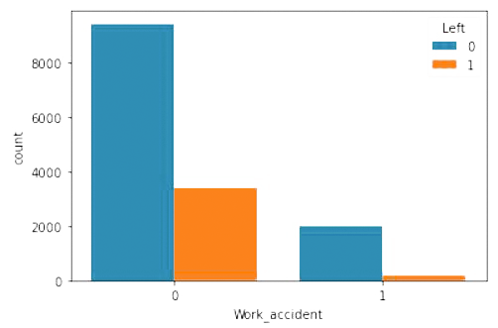
Work accident (0.15)
Summary
Key
Intro
Significance
Correlation
EDA
Attrition Rates based on Work accident
Suffered from a work accident = 70.484%
Did not suffer from work accident = 92.208%
While it may seem through correlation that work accidents is pivotal in attaining attrition rate, the count plot seems to show a clearer picture. Contrary to the expectation, attrition rate increases in employees who suffered a workplace accident. The significant difference in sample space could have caused this absurd result to occur.
Notes:
accident_dependence= sns.countplot(x="Work_accident", hue="Left",data=df)

Slide 9
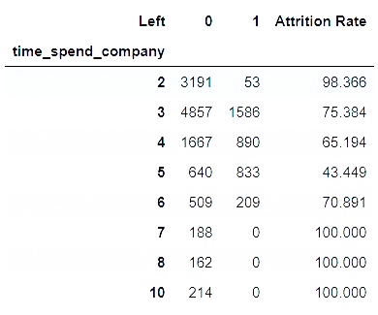
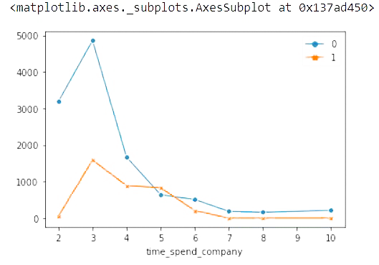
Time Spent in company (-0.14)
Key
Intro
Summary
Correlation
Significance
EDA
The attrition rate decrease until the employee is in his/her 5th year, at which point it is the lowest, a mere 43%. Employees who have spent greater than 6 years in the company stay. Hence focusing on the employees in their 5th year with the company can be extremely beneficial in increasing attrition. In terms of volume most employee leave in the 6th year.
Notes:
pdc=pd.crosstab(df["time_spend_company"], df["Left"])
sns.lineplot(data=pdc, markers=True, dashes=False)
pdc['Attrition Rate']=round(pdc[0]/(pdc[0]+pdc[1])*100,3)

Slide 10
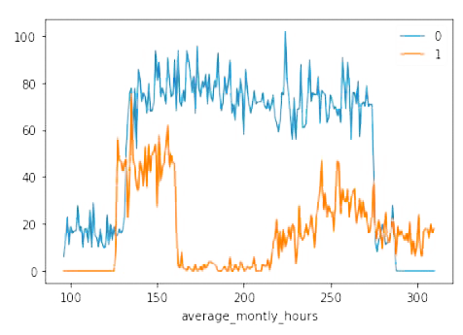
Average Monthly Hours (-0.071)
Key
Intro
Summary
Correlation
Significance
EDA
Although the correlation of this column is significantly lower than the previous columns it provides us with beneficial data.
No employee with average monthly hours less than 125 has left the company.
Attrition rate drops down significantly when average monthly hours reach 276.
No Employee with monthly hours greater than 288 stayed in the company.
Attrition rate for average monthly hours in the range of 167 to 215 is very high hence it could be considered as the most optimal range.
Notes:
avg_month=pd.crosstab(df["average_montly_hours"], df["Left"])
sns.lineplot(data=avg_month, dashes=False)

Slide 11
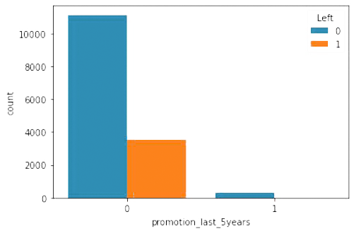
Promotion in Last 5 years (0.062)
Key
Intro
Summary
Correlation
Significance
EDA
The statistics suggest promotion is sparsely rewarded in the company and that it is an effective measure to improve the attrition rate.
No employee who was rewarded promotion left the company
Notes:
promotion_dependence= sns.countplot(x="promotion_last_5years", hue="Left",data=df)

Slide 12
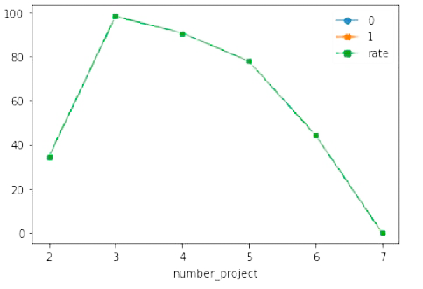
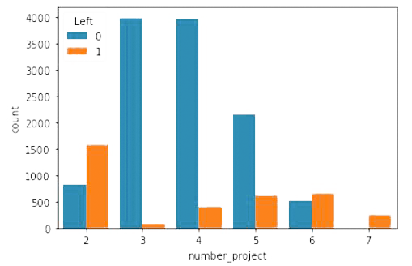
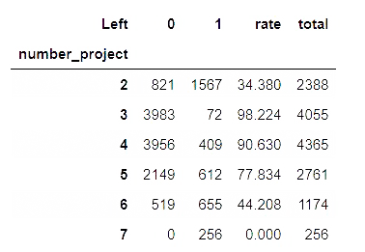
Number Of Projects (0.024)
Key
Intro
Summary
Correlation
Significance
EDA
While 2 projects make employees feel underappreciated, 7 projects are too much too handle.
Most optimal value for assigning projects is 3 and it could be extended to 4.
Notes:
sns.countplot(x=df['number_project'],hue=df['Left'])
projects= pd.crosstab(df["number_project"], df["Left"])
projects['rate']=round(projects[0]/(projects[1]+projects[0])*100,3)
sns.lineplot(data=projects, markers=True, dashes=False)

Slide 13
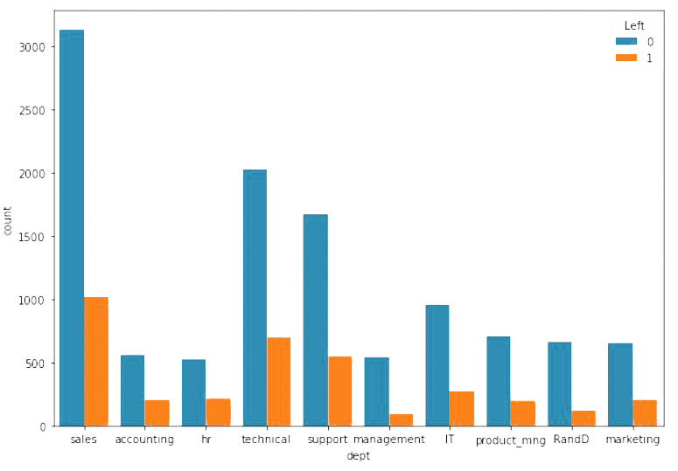
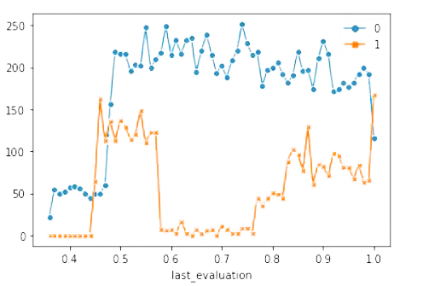
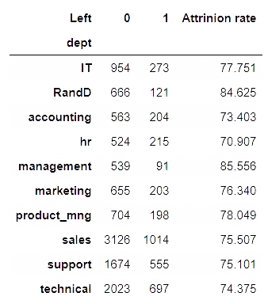
Departments and Last Evaluation(0.0066)
Key
Intro
Summary
Correlation
Significance
EDA
These two columns have the least correlation with the data and hence are the least important in terms of production.
The most desirable values for last evaluation lie between 0.6 and 0.78.
No departments has alarmingly low attrition level
Notes:
sns.lineplot(data=last_dep, markers=True, dashes=False)
plt.figure(figsize=(10,7))
dept_dependence= sns.countplot(x="dept", hue="Left",data=df)
plt.show()

Slide 14
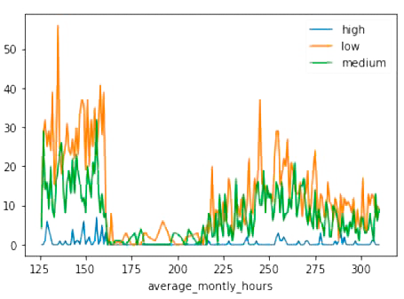
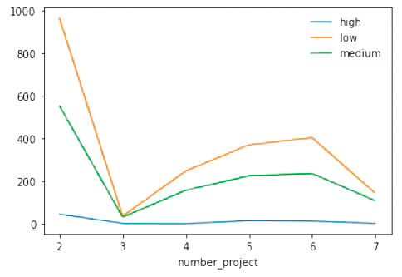
Summary
Intro
Correlation
Interestingly, Salary does not affect the change in attrition rate caused by average monthly hours or number of projects. They have low correlation stats and the trend remains the same.
Hence increasing the salary is not a viable solution.
EDA
Notes:
work_hours_to_salary_ratio=pd.crosstab(df_left["average_montly_hours"],df_left['salary'])
sns.lineplot(data=work_hours_to_salary_ratio, dashes=False)
projects_to_salary_ratio=pd.crosstab(df_left["number_project"],df_left['salary'])
sns.lineplot(data=projects_to_salary_ratio, dashes=False)

Slide 15
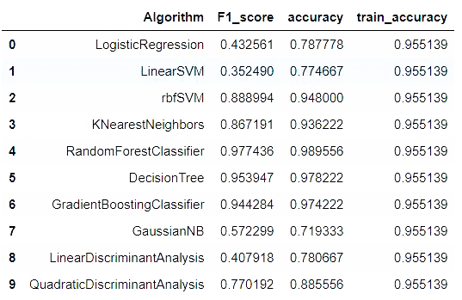
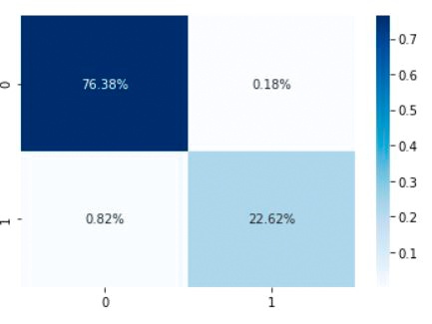

Final Model – Random Forest
Final Model – Random Forest
Stats for different Algorithms
Confusion Matrix for Final Model
Summary
Intro
Correlation
EDA
Statistics for Final Model
Our Model can help the company predict if an employee will leave or not with 97.9% accuracy.
Notes:
rfc=RandomForestClassifier(random_state=123)
rfc.fit(x_train,y_train)
predict_train= rfc.predict(x_train)
predict_test= rfc.predict(x_test)
print("Train Accuracy: "+ str(round(metrics.accuracy_score(y_train,predict_train),3)*100))
print("Test Accuracy: "+ str(round(metrics.accuracy_score(y_test,predict_test),3)*100))
print("Train F1: "+ str(round(metrics.f1_score(y_train,predict_train),3)*100))
print("Test F1: "+ str(round(metrics.f1_score(y_test,predict_test),3)*100))
cm=metrics.confusion_matrix(y_test,predict_test)
sns.heatmap(cm/np.sum(cm), annot=True, fmt='.2%', cmap='Blues')

Slide 16
Summary
Values for people who are most likely to leave
Satisfaction | Salary | Work Accident | Years Spent | Monthly Hours | Promotion | Projects | Department | Last Evaluation
Below 0.1 | low | 0 | 5 | 288 | 0 | 7 | tech | 0.45-0.6
Values for people who are likely to leave but can be retained
Satisfaction | Salary | Work Accident | Years Spent | Monthly Hours | Promotion | Projects | Department | Last Evaluation
0.38 – 0.43 | low/med | 0 | 6 | 276 | 0 | 2, 5-7 | any | 0.45-0.6
Summary
Intro
Correlation
EDA
Values for people who are likely to leave but can be retained
Satisfaction | Salary | Years Spent | Monthly Hours | Promotion | Projects | Last Evaluation
0.45-0.65 | high | Above 6 | 167- 215 | 1 | 3-4 | 0.61-0.78
Increasing the salary wont affect attrition
Rewarding Promotion will significantly increase the attrition
Attrition Rate is very low for employees in their 6th year but if they are retained they are most likely to stay.

Slide 17
Thanks For Viewing
The project
Report!!

